Slide 1

MINOR PROJECT - I ON HOSPITAL MANAGEMENT SYSTEM (MCA – I SEMESTER; BATCH 2022-24)
Internal Guide
MS. PARUL ARORA
&DR. RITIKA WASON (Asst./Assoc. Prof., BVICAM, New Delhi)
Presentation by
Harshit Chamoli
Jyoti Sharma
Roopansh Sethi
17-02-2023
Notes:
1

Slide 2
Contents
Introduction
Features
Technologies
Objectives
Data Flow Diagram (0 AND 1 level DFD)
Module

Slide 3
Problem Description
The Covid-19 pandemic has created a multitude of acute challenges for health care delivery organizations and at this point every hospital needs a robust hospital management software in which the person can rely upon.
The Hospital Management System developed by us will not only store the data of patients and healthcare providers but also provide a user friendly GUI and easy search options so that they can access their data rapidly which will help the hospital to function in a finer manner.

Slide 4
Aim and Objectives
Aim:
Our project “Hospital Management System” is developed in JAVA language, which includes methods which helps the user to add, edit, view, search and delete the patient‘s details.
Objectives:
This system has a great graphic interface which helps the user to understand the functionality of the software.
To maintain the data of patient‘s without any complications and in a systematic manner.
Data accessibility is much faster in case of emergency.
Easy to amend data which will help the hospital to keep accurate records.
It contains the patient’s information like Patient’s name, disease, admit date etc.
Our project‘s aim at managing the data of hospital easily and provide the complete solution for hospital and health care services.

Slide 5
Methodology and Technology Used
Methodology used for Project Development:
Waterfall Model of SDLC
Technology used for Project Development:
Integrated Development Environment (IDE): NETBEANS IDE 8.2
Database: MySQL 8.0

Slide 6
Project Modules and My Role
Project Modules:
Login screen
Reception
Diagnosis
My Role in the Project:
Design of GUI (User Interface)
Design of Database Schema
Development of Business Logic

Slide 7
System Design

Slide 8
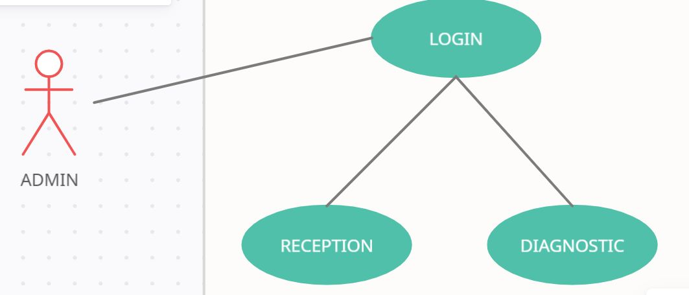
Use Case Diagram

Slide 9
Data Flow Diagram (Level - 0)
RECEPTION MODULE
DIAGNOSIS MODULE
HOSPITAL MANAGEMENT SYSTEM
DATABASE

Slide 10
Data Flow Diagram (Level - 1)
LOGIN
ID AND PASSWORD
RECEPTION
DIAGNOSTICS
TABLE 1
TABLE 2

Slide 11
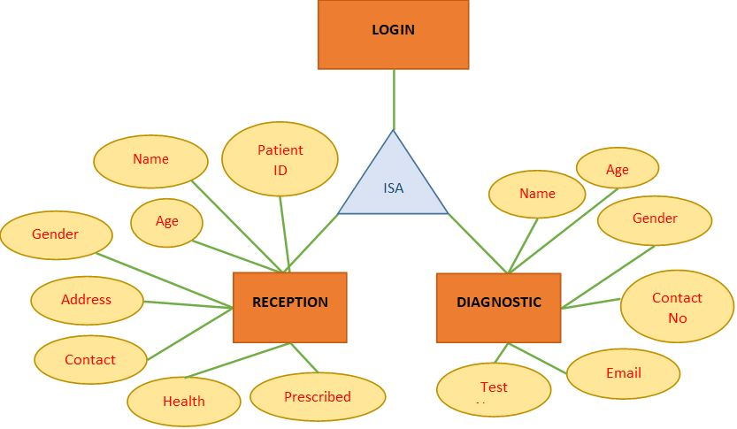
Entity-Relationship (E-R) Diagram

Slide 12
Title of Diagram
Depending upon the Nature of Project, Draw the Following Diagrams:
Control Flow diagrams
State Diagrams/Sequence Diagrams
Class Diagrams
Collaboration Diagrams/Activity Diagrams

Slide 13
Screenshots

Slide 14
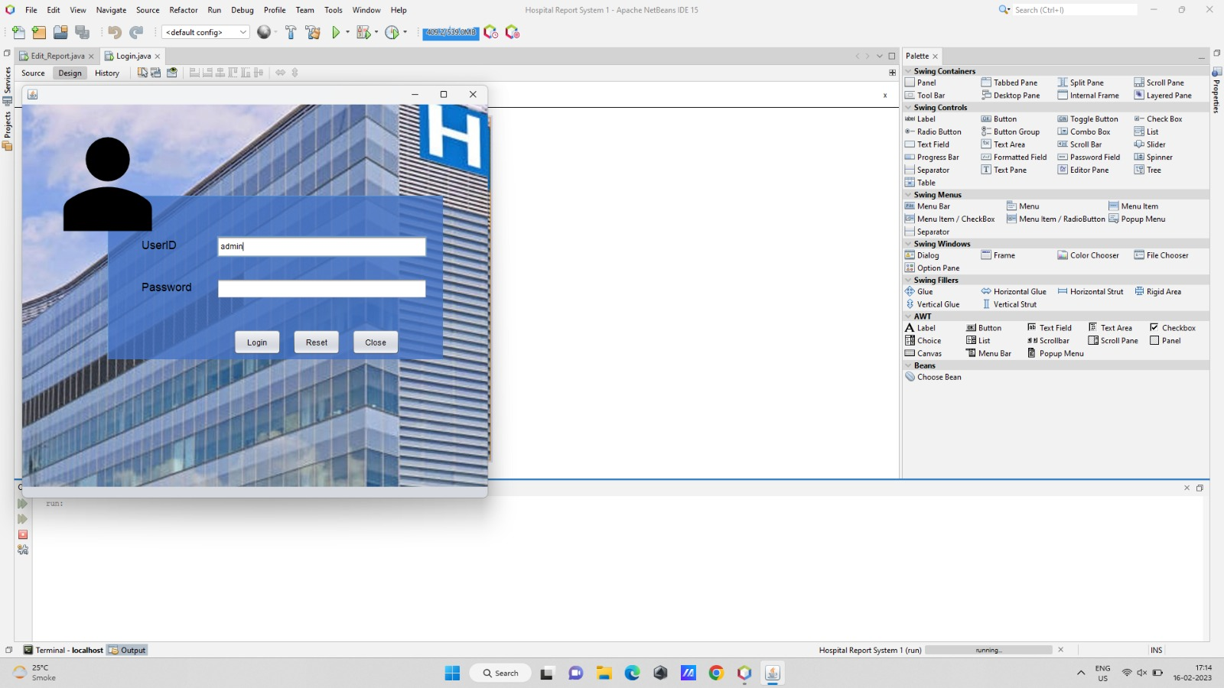
Screenshot - 1: Login page

Slide 15
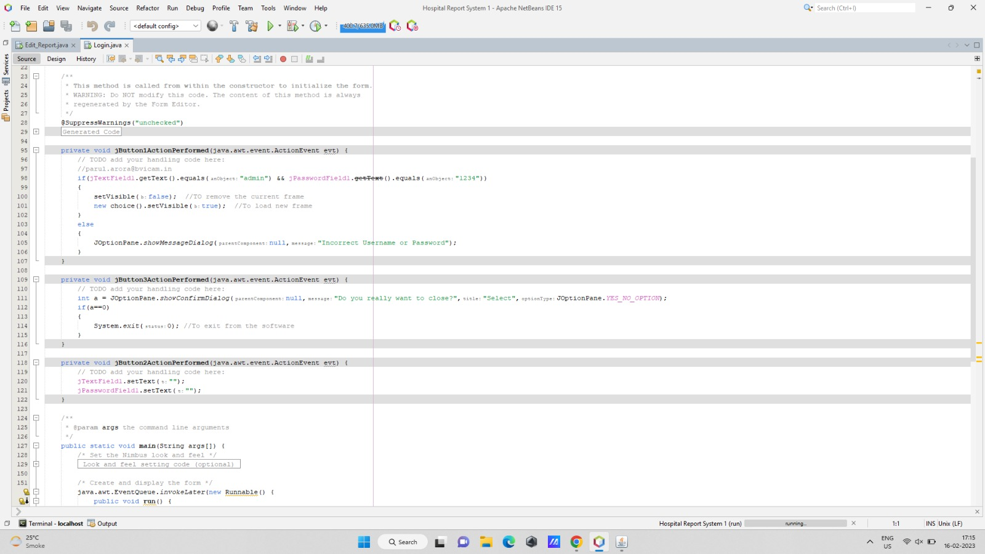
Screenshot - 2: code

Slide 16
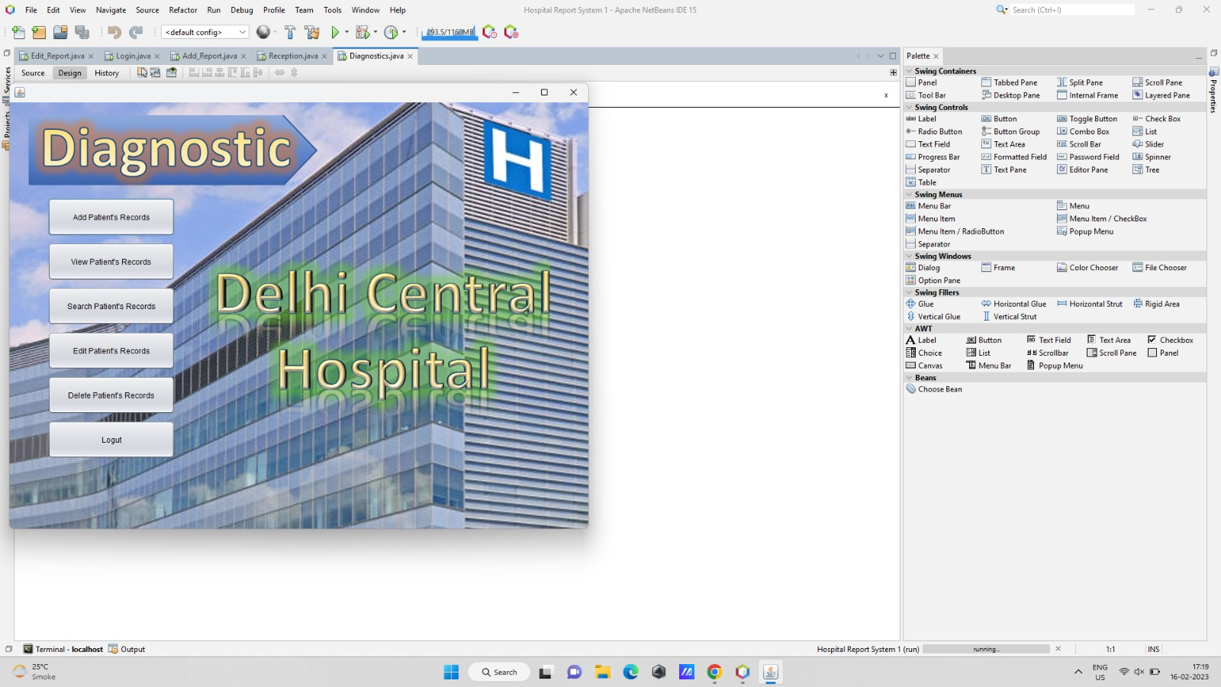
Screenshot - 3

Slide 17
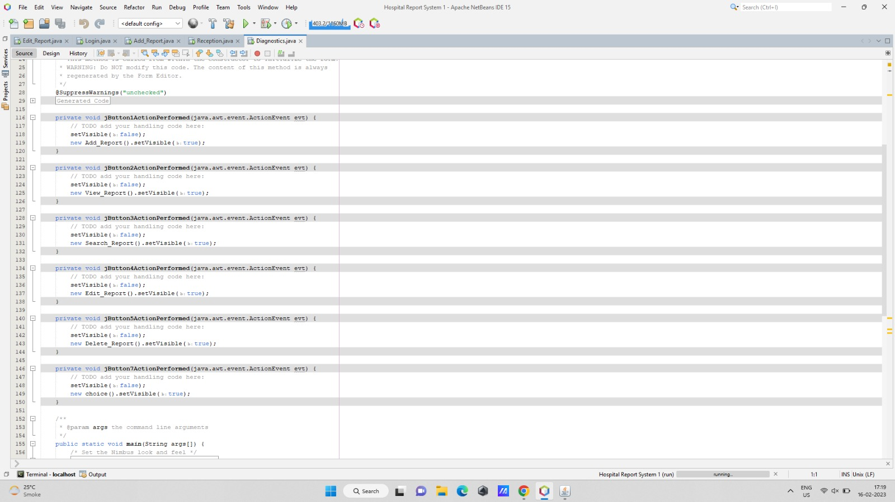
Screenshot - 4

Slide 18
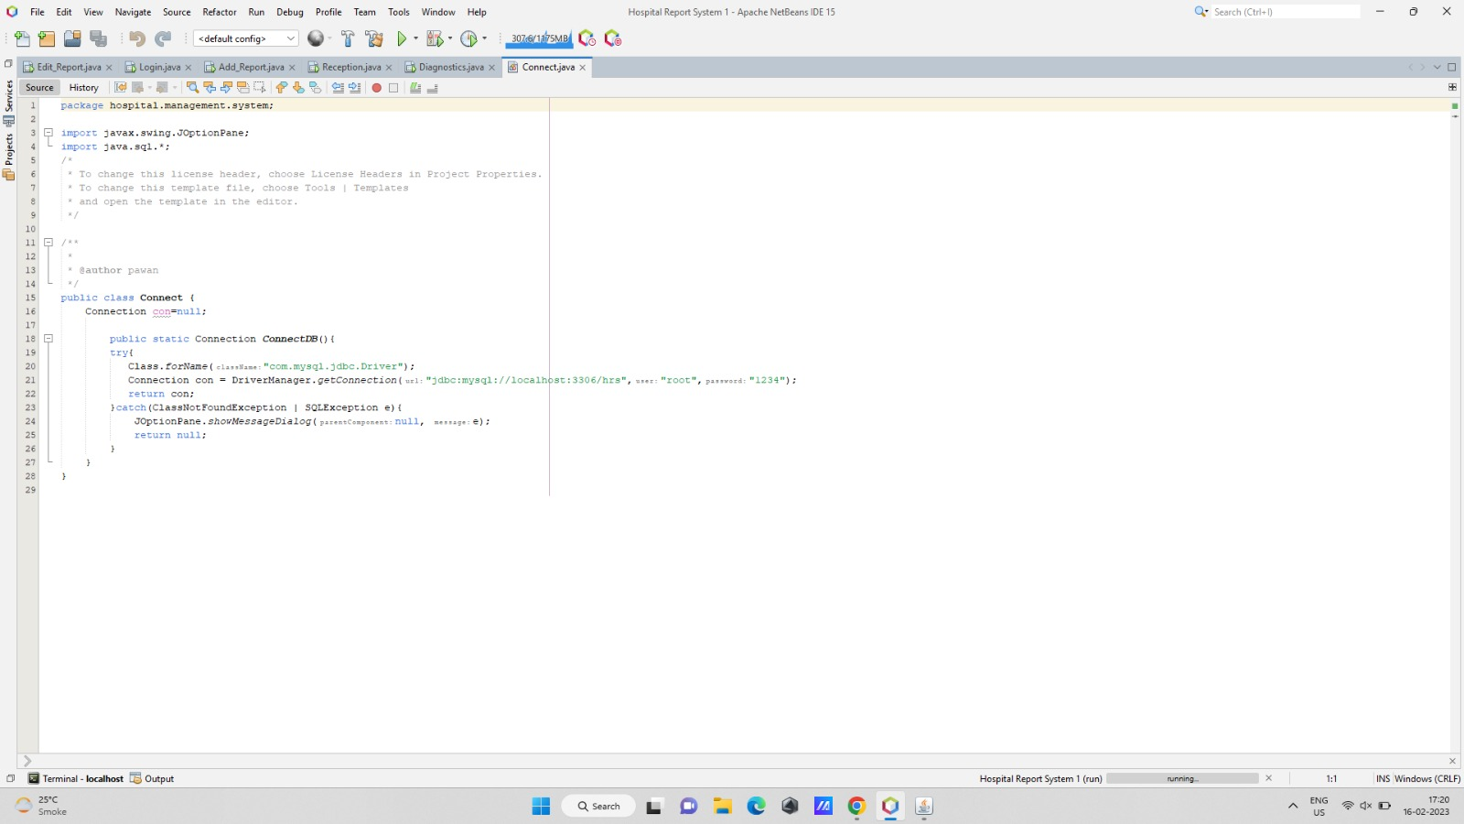
Screenshot - 5

Slide 19
Screenshot - 5

Slide 20
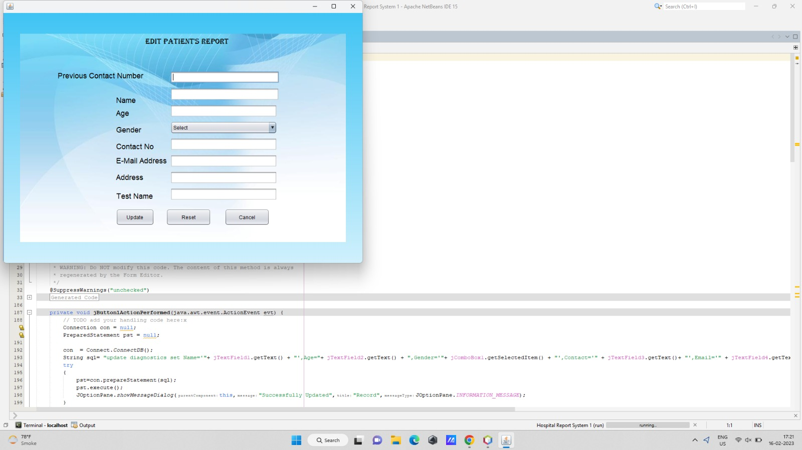
Screenshot - 6

Slide 21
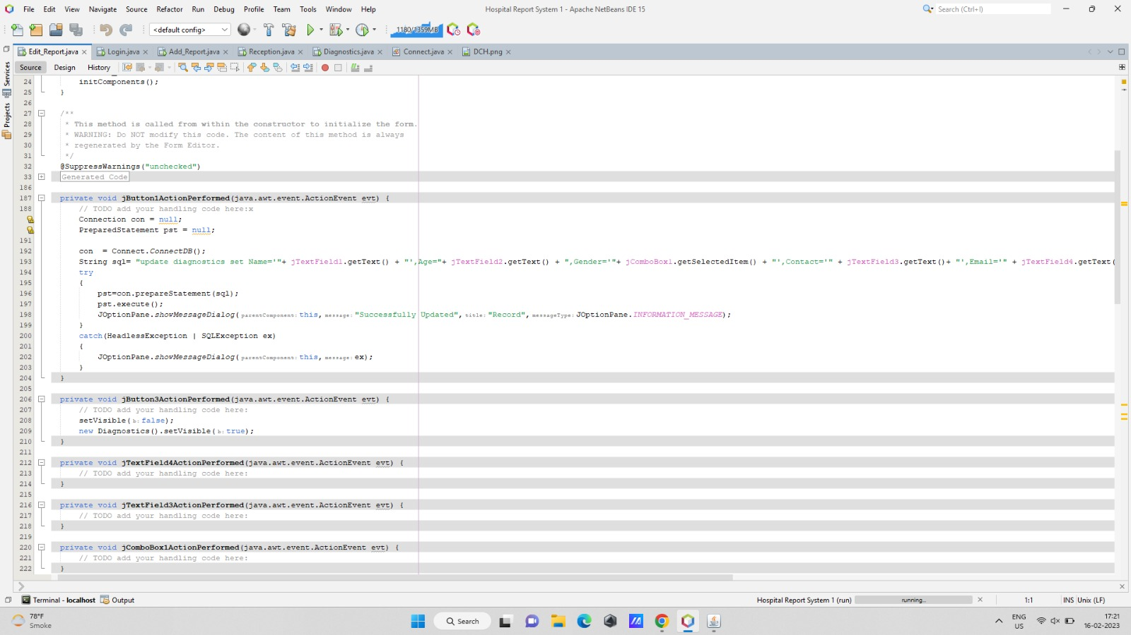
Screenshot - 7

Slide 22
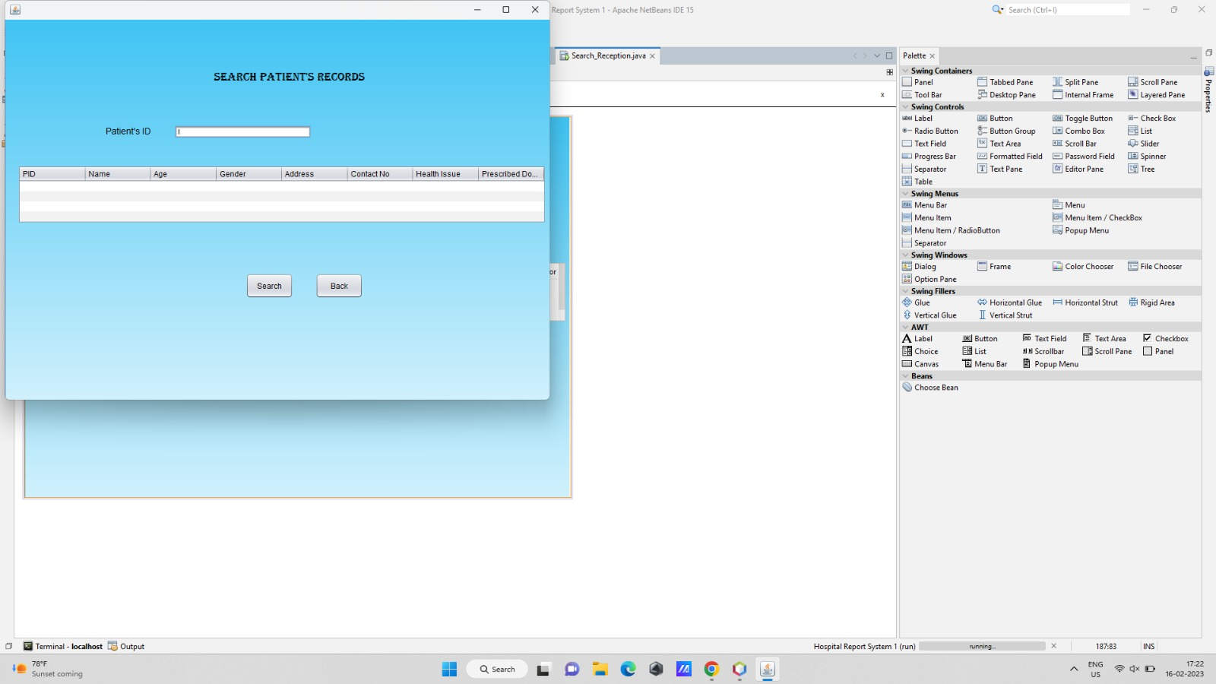
Screenshot - 8

Slide 23
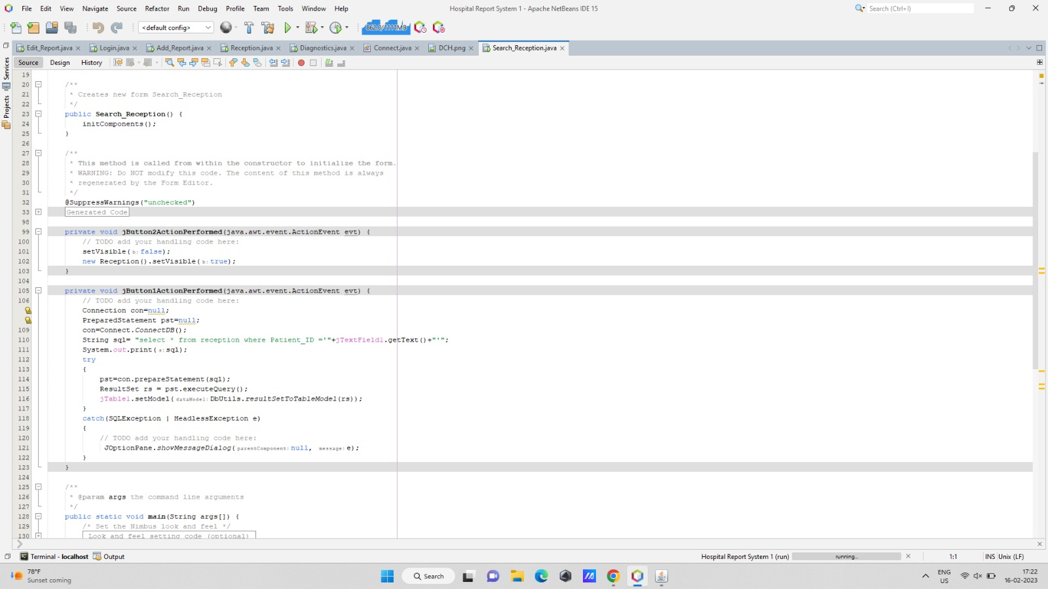
Screenshot - 9

Slide 24
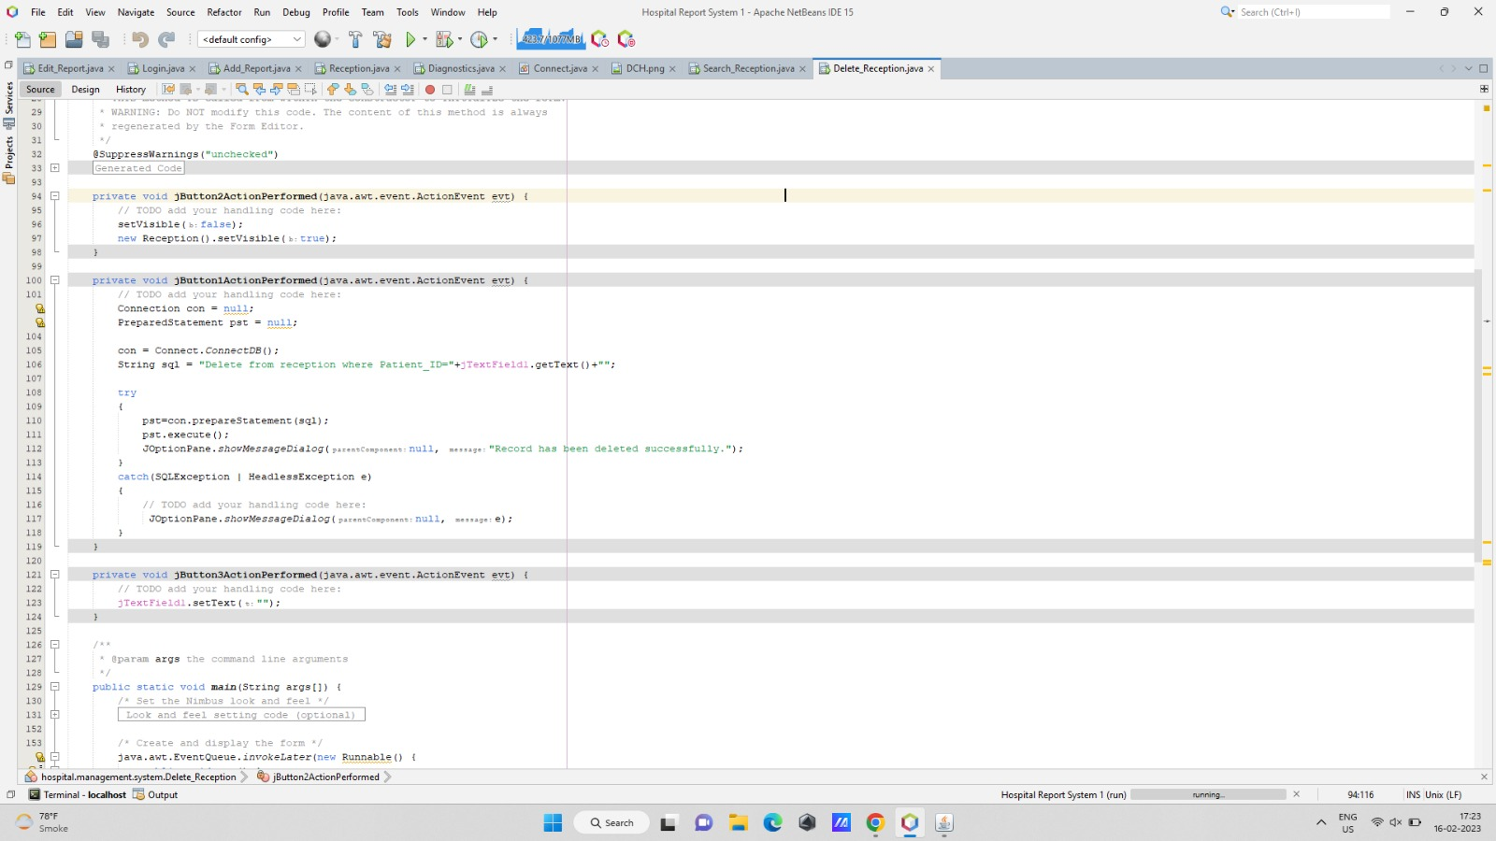
Screenshot - 10

Slide 25
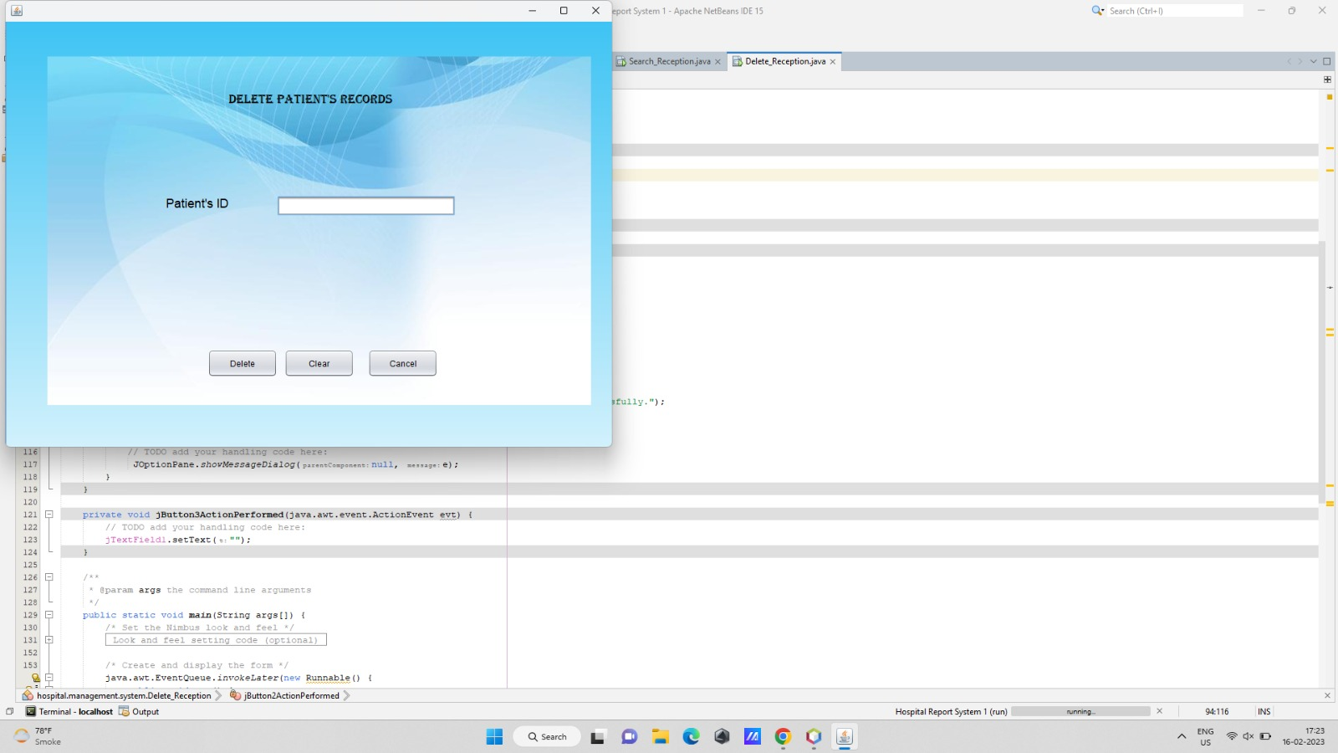
Screenshot - 11

Slide 26
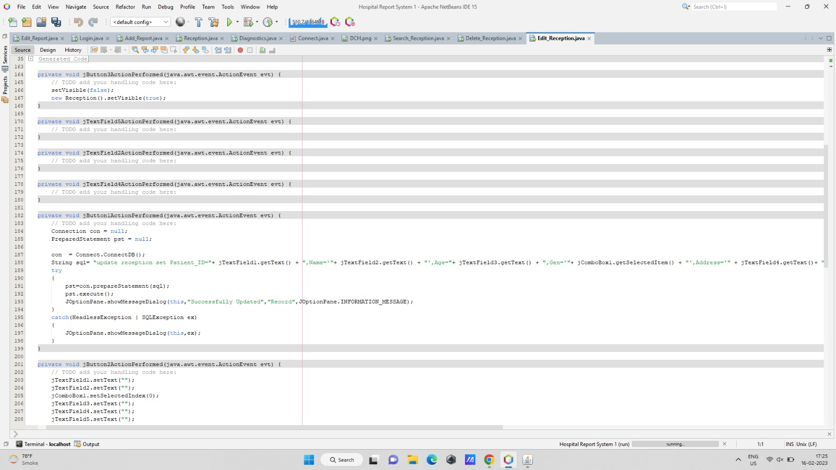
Screenshot - 12

Slide 27
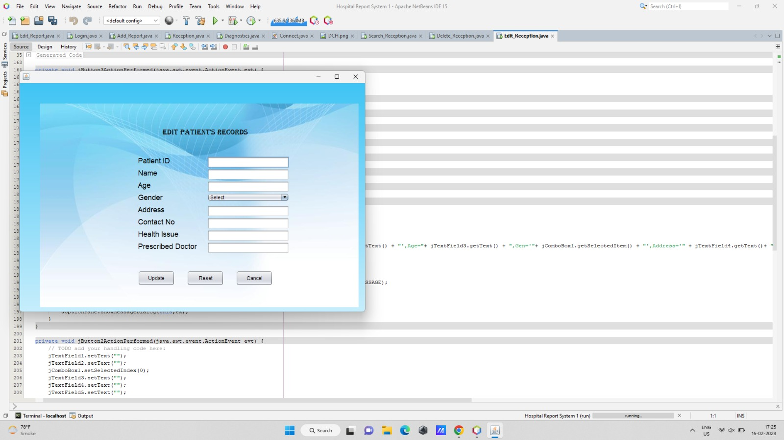
Screenshot - 13

Slide 28
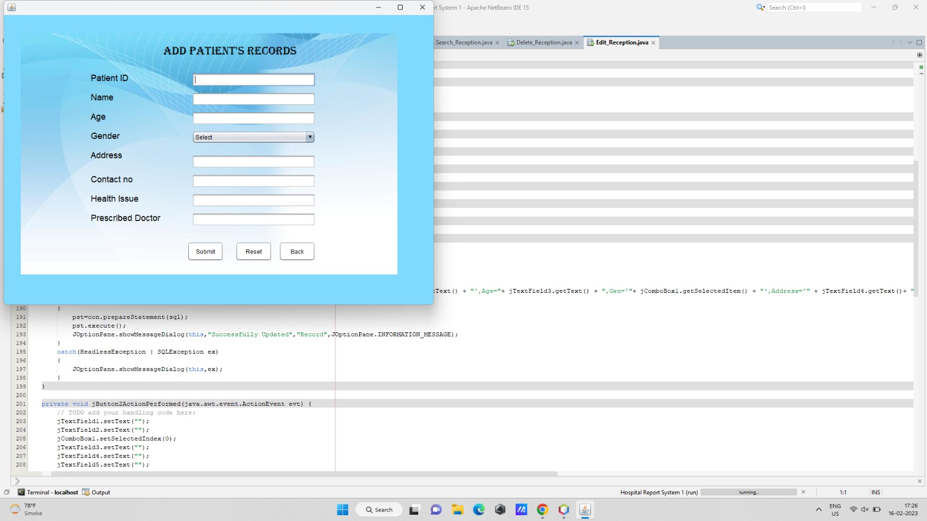
Screenshot - 14

Slide 29
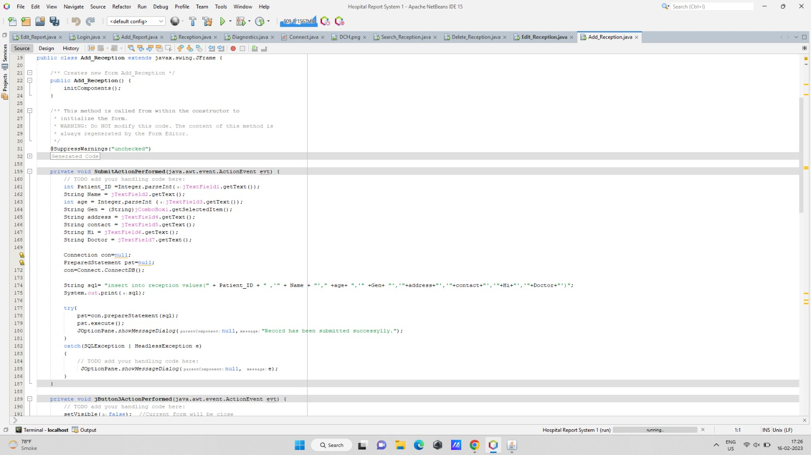
Screenshot - 15

Slide 30
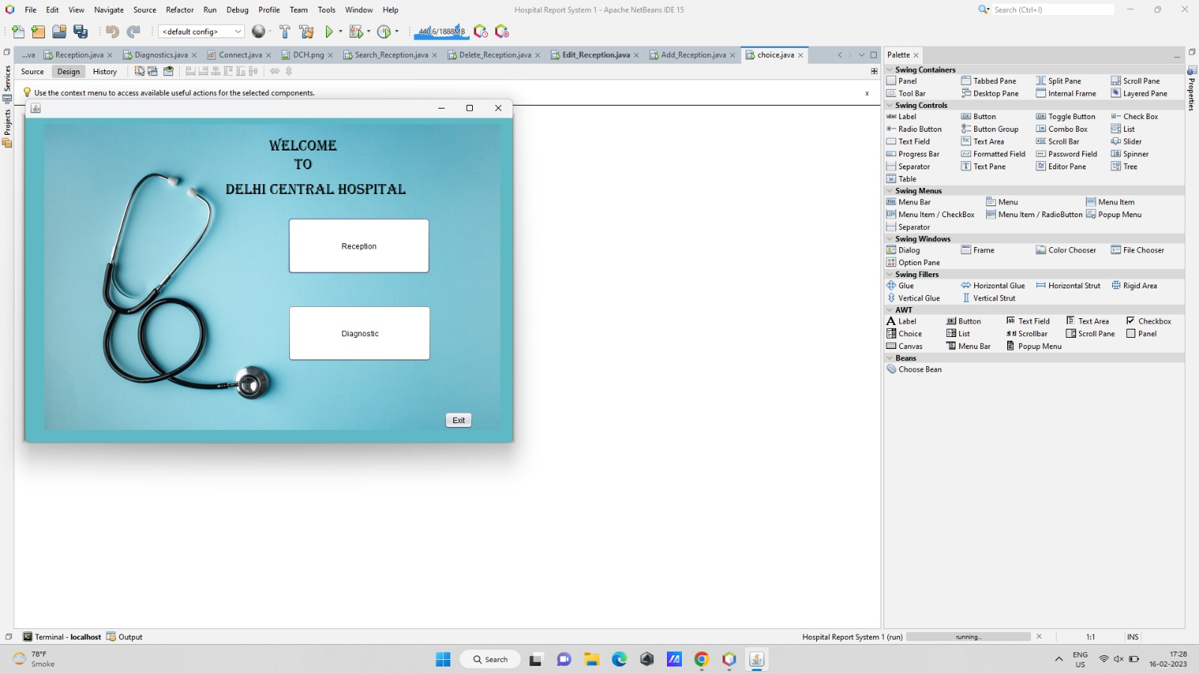
Screenshot - 16

Slide 31
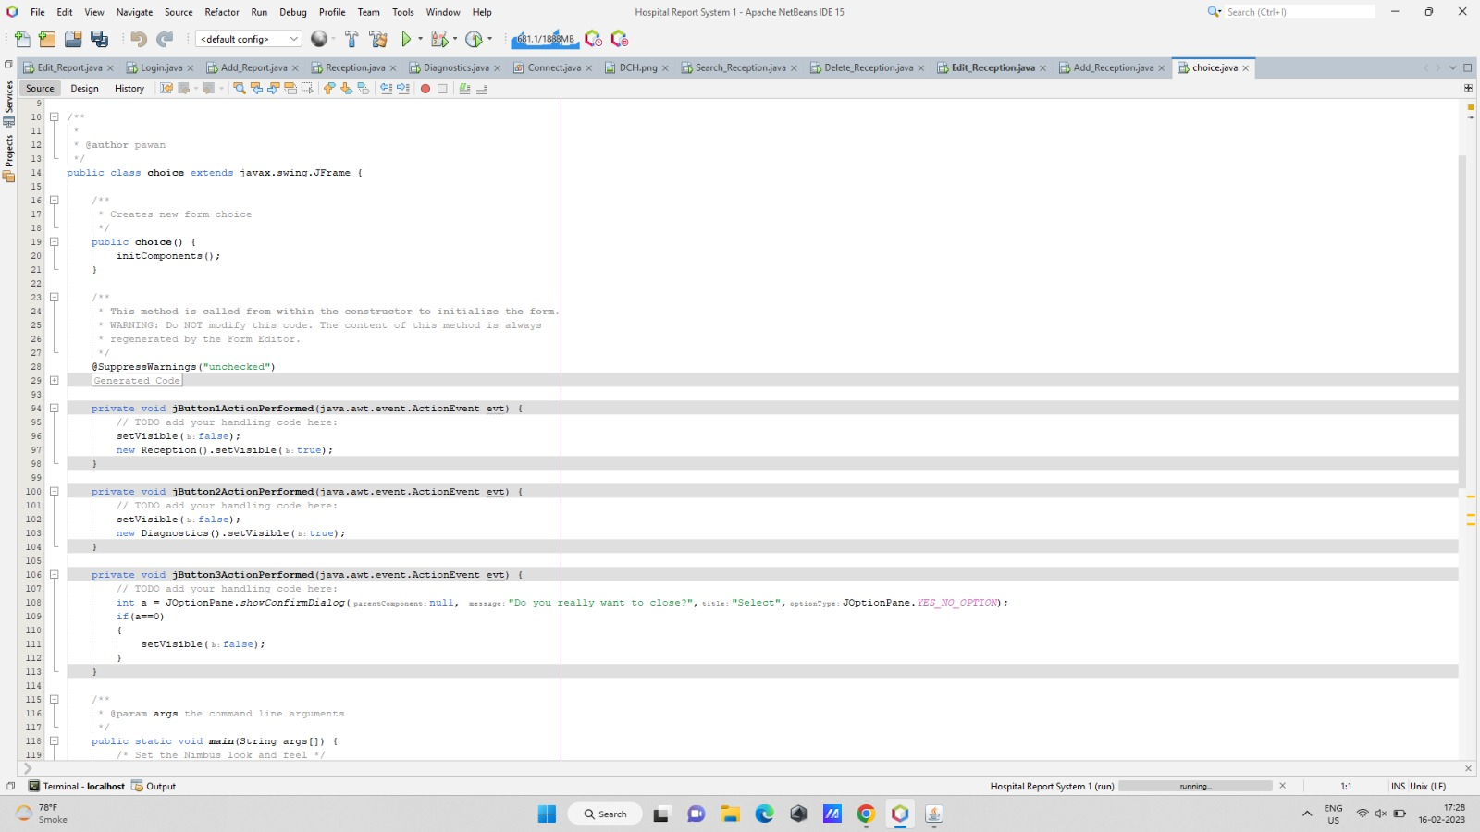
Screenshot - 17

Slide 32
Testing of the Project
Depending upon the Nature of Project, Design and Present the Test Cases
Id | Test Case Description | Test Case Input | Test Results |  | Status | Corrective Measure
 |  |  | Expected | Actual
1 | Admin can successfully create the report/diagnostics | All the fields asked in the create report page are filled properly. | report is created successfully | report is created successfully | Pass | None
2 | All the reports that are successfully created should be displayed here. | No input | Successfully created reports are displayed. | Successfully created reports are displayed. | Pass | None
3 | Admin can update the reports | All the fields asked are updated | Updating done successfully | Updating done successfully | Pass | None

Slide 33
Conclusion
An IDE based application developed for Hospital management
JAVA and SQL Programming is used for System Development.
Waterfall model of SDLC has been followed for development of the project.
The developed application has following features:
Responsive user-friendly interfaces to interact with the system.
Three-tier architecture.
Other features as per the project’s nature.

Slide 34
Future Scope
Multi-language support can be provided for different regional customer
The developed project may be converted to a software application
Different modules for different patients affected with the same disease for the survey purpose

Slide 35
Bibliography
Books:
BOOK 1 – Introduction to programming using java BY Decker and Hirshfield
BOOK 2 – SQL the programming language of oracle BY ivan bayross
Websites:
WWW.JAVAT POINT
WWW.MYSQL.COM
NETBEANS.APACHE.ORG
WWW.W3SCHOOLS.COM

